Slide 1
Project Presentation of Back End Engineering Project (BEE) (22CS026)
On
Campus Connect
Bhuvesh Mittal-2210991450
Daanushi-2210991469
Divya Arora-2210991531
Supervised By
Prernu Mittan
Department of Computer Science and Engineering,
Chitkara University, Punjab

Slide 2
Project Statement
In a university setting, students, faculty, and clubs often face challenges in communication, event management, and academic tracking. The lack of a unified platform leads to fragmented information, inefficient processes, and reduced engagement. The University Engagement and Management System (UEMS) aims to address these issues by providing an integrated platform that enhances interaction, event management, academic tracking, and real-time communication for all university stakeholders.

Slide 3
Approximate duration (in hours) to complete the project:
Weeks | Time | Work to be Done
Week 1 | 4 hours | Project Discussion
Week 2
Week 3
Week 4
Week 5
Week 6
Week 7
Week 8

Slide 4
Proposed Project In charge
University Engagement and Management System (UEMS) -CampusConnect(CC)

Slide 5
Check Points
Does the project statement result in a product? If yes, what type of product?
Ans:-Yes, the project statement results in a product. It is a web-based university engagement and management platform. This product facilitates various functionalities for students, faculty, and clubs within a university setting.
b. If it is a product, can a prototype be made, if not, what is it, which we can produce that our teachers can evaluate.
Ans:- Yes, a prototype can be made. The prototype would be a working version of the web application demonstrating the key features such as:
User authentication (students, faculty, clubs)
Event management (creating, joining, viewing events)
Quiz management (uploading, taking quizzes)
Attendance tracking
Real-time chat functionality
Profile management
Club activities and management

Slide 6
c. Does the project statement use multiple concepts to achieve the outcome? (yes/no)
Ans:- Yes, the project statement uses multiple concepts to achieve the outcome. These include:
Web Development: Frontend (React.js) and Backend (Node.js, Express.js)
Database Management: MongoDB
Authentication and Authorization: Implementing secure login and role-based access control.
Event Management: Creating and managing events.
Quiz and Attendance Management: Uploading quizzes and tracking attendance.
User Experience: Designing user interfaces and user experience flows.
d. Does it have enough for our team members to do sufficient amount of work? (yes / no)
Ans:- Yes, the project has enough scope for team members to engage in a sufficient amount of work. The tasks can be divided into different modules such as:
Frontend Development: Designing and implementing the user interface.
Backend Development: Setting up the server, database interactions, and API development.
Authentication: Implementing secure login and role management.
Real-Time Features: Developing the real-time chat functionality.
Event and Quiz Management: Creating the logic for event creation, joining, and quiz management
Database Design: Designing and managing the database schema.

Slide 7
Technical Nodes
Subject / Area / Topic | Technical Nodes
Frontend Development | React.js
Backend Development | Node.js, Express.js
Database Management | MongoDB
Authentication and Authorization | JWT

Slide 8
Prerequisties for doing the project
Knowledge:
Basic understanding of web development (HTML, CSS, JavaScript)
Familiarity with frontend frameworks (React.js)
Knowledge of backend development (Node.js, Express.js)
Understanding of relational and non-relational databases (PostgreSQL, MongoDB)
Basic concepts of authentication and authorization
Familiarity with RESTful API design
Concepts:
MVC (Model-View-Controller) architecture
RESTful APIs
CRUD operations
Asynchronous programming and Promises
State management in frontend frameworks
Responsive design principles
Security best practices for web applications
Materials:
Tutorials and documentation for React.js, Node.js, Express.js, PostgreSQL, and MongoDB
Example projects and source code for similar applications
Books and online courses on full-stack web development
Design resources for creating user interfaces (wireframes, mockups)

Slide 9
Materials Required
Development tools-
IDE/Text Editor: Visual Studio Code, Sublime Text (available for download from their official websites)
Version Control: Git, GitHub (available at Git and GitHub)
Package Manager: npm (included with Node.js installation from Node.js)
Frontend-
React.js: React.js
Backend:
Node.js and Express.js: Node.js, Express.js
JWT (jsonwebtoken): JWT
Database:
MongoDB: MongoDB
Design and Prototyping Tools:
Figma: Figma
Adobe XD: Adobe XD

Slide 10
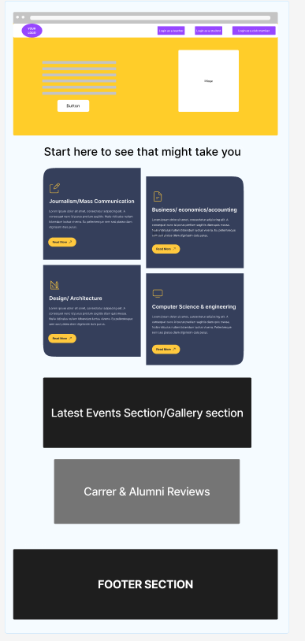
Blueprint

Slide 11
Thank You
11

